Slide 1
Chapter 1 The Foundations : Logic and Proofs Kenneth H. Rosen 7th edition
Section 1.4 : Predicates and Quantifiers

Slide 2
Predicates
Helps in converting a non propositional statement into a proposition.
What to identify?
Variables
Predicates
Propositional Function

Slide 3
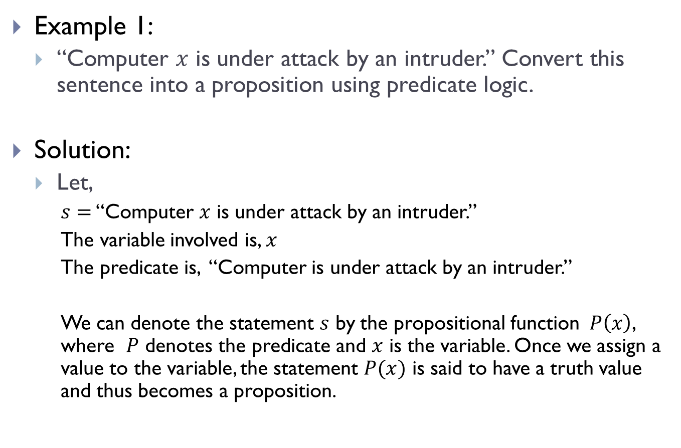
Predicates(Contd.)
Example 1:
“Computer $x$ is under attack by an intruder.” Convert this sentence into a proposition using predicate logic.
Solution:
Let,
$s=$ “Computer $x$ is under attack by an intruder.”
The variable involved is, $x$
The predicate is, “Computer is under attack by an intruder.”
We can denote the statement $s$ by the propositional function $P\left(x\right)$, where $P$ denotes the predicate and $x$ is the variable. Once we assign a value to the variable, the statement $P(x)$ is said to have a truth value and thus becomes a proposition.

Slide 4
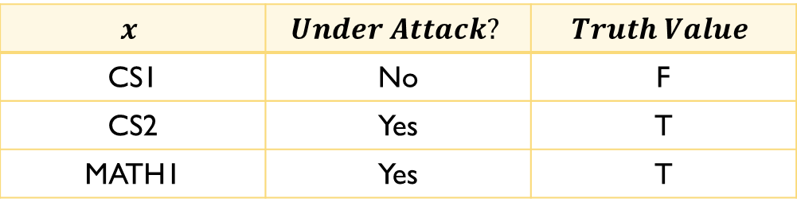
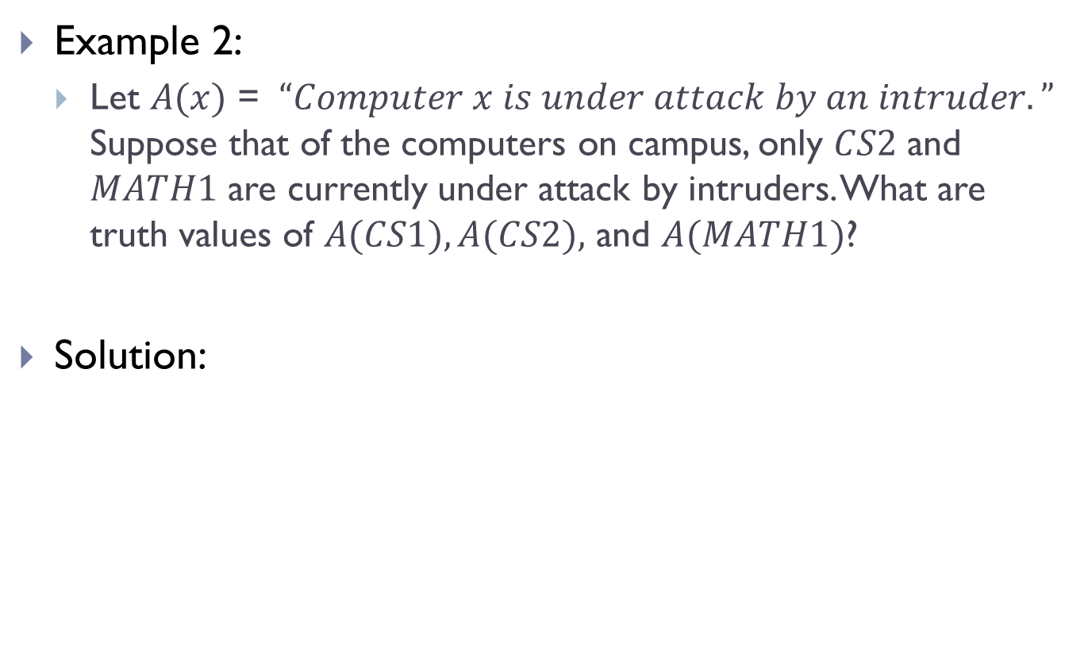
Predicates(Contd.)
Example 2:
Let $A(x)$ = $“Computer x is under attack by an intruder.”$ Suppose that of the computers on campus, only $CS2$ and $MATH1$ are currently under attack by intruders. What are truth values of $A(CS1), A(CS2),$ and $A(MATH1)$?
Solution:
$$x$$ | $$Under Attack?$$ | $$Truth Value$$
CS1 | No | F
CS2 | Yes | T
MATH1 | Yes | T

Slide 5
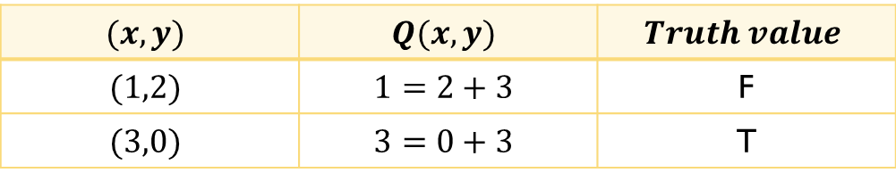
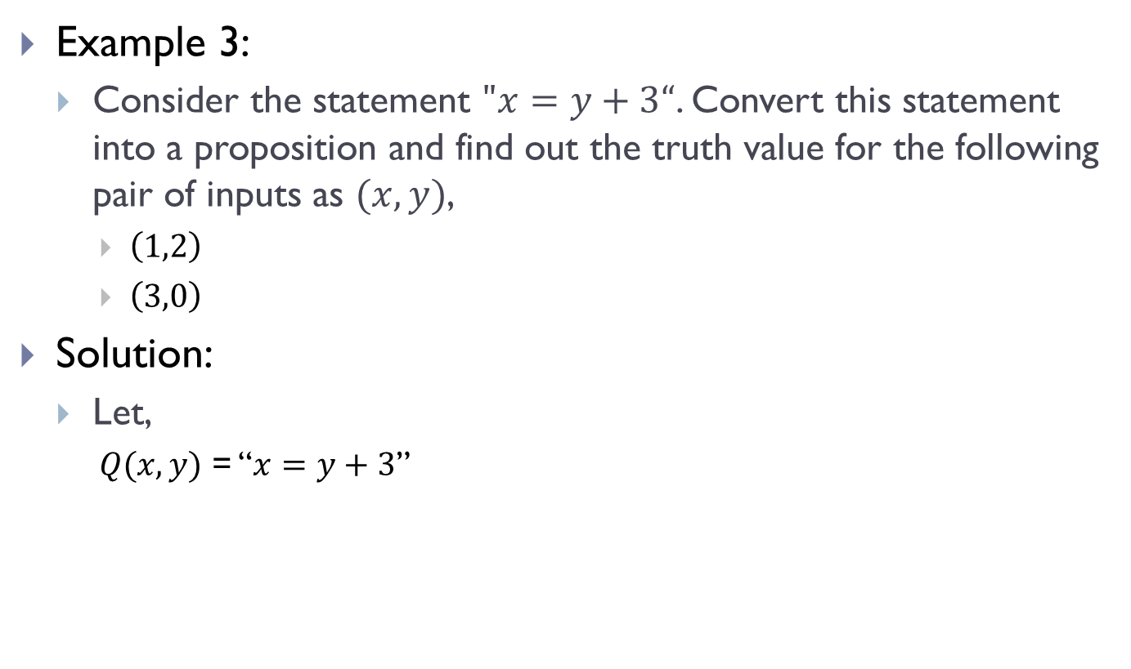
Predicates(Contd.)
Example 3:
Consider the statement $"x=y+3“$. Convert this statement into a proposition and find out the truth value for the following pair of inputs as $(x,y)$,
$\left(1,2\right)$
$\left(3,0\right)$
Solution:
Let,
$Q(x,y)$ = “$x=y+3$”
$$(x,y)$$ | $$Q(x,y)$$ | $$Truth value$$
$$(1,2)$$ | $$1=2+3$$ | F
$$(3,0)$$ | $$3=0+3$$ | T

Slide 6
Predicates(Contd.)
Pre-Conditions
The statements that describe valid input are known as pre-conditions.
Post-Conditions
The conditions that the output should satisfy when the program has run are known as post-conditions.

Slide 7
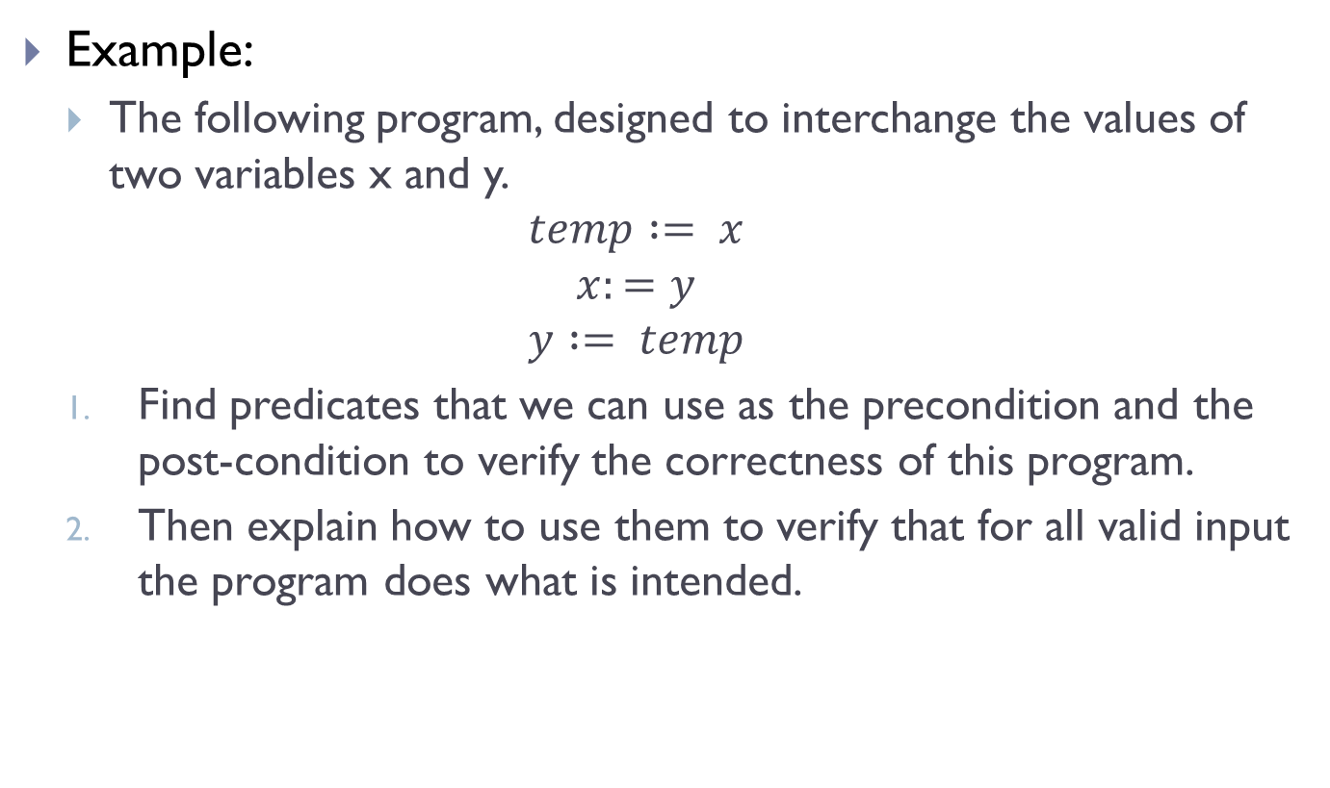
Predicates(Contd.)
Example:
The following program, designed to interchange the values of two variables x and y.
$$temp := x$$
$$x:=y$$
$$y := temp$$
Find predicates that we can use as the precondition and the post-condition to verify the correctness of this program.
Then explain how to use them to verify that for all valid input the program does what is intended.

Slide 8
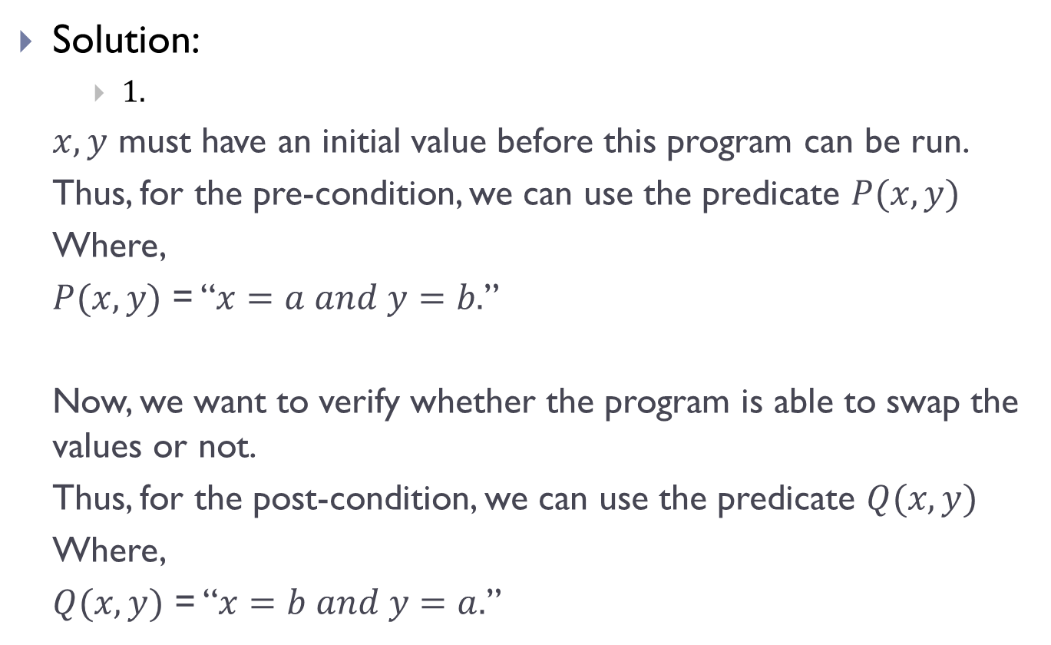
Predicates(Contd.)
Solution:
$1.$
$x,y$ must have an initial value before this program can be run.
Thus, for the pre-condition, we can use the predicate $P(x,y)$
Where,
$P(x,y)$ = “$x=a and y=b.$”
Now, we want to verify whether the program is able to swap the values or not.
Thus, for the post-condition, we can use the predicate $Q(x,y)$
Where,
$Q(x,y)$ = “$x=b and y=a.$”

Slide 9
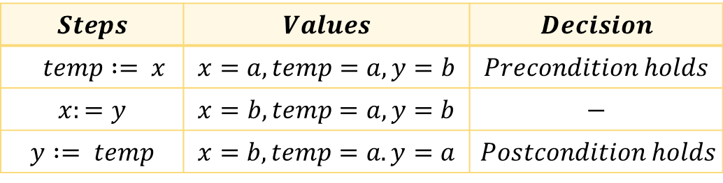
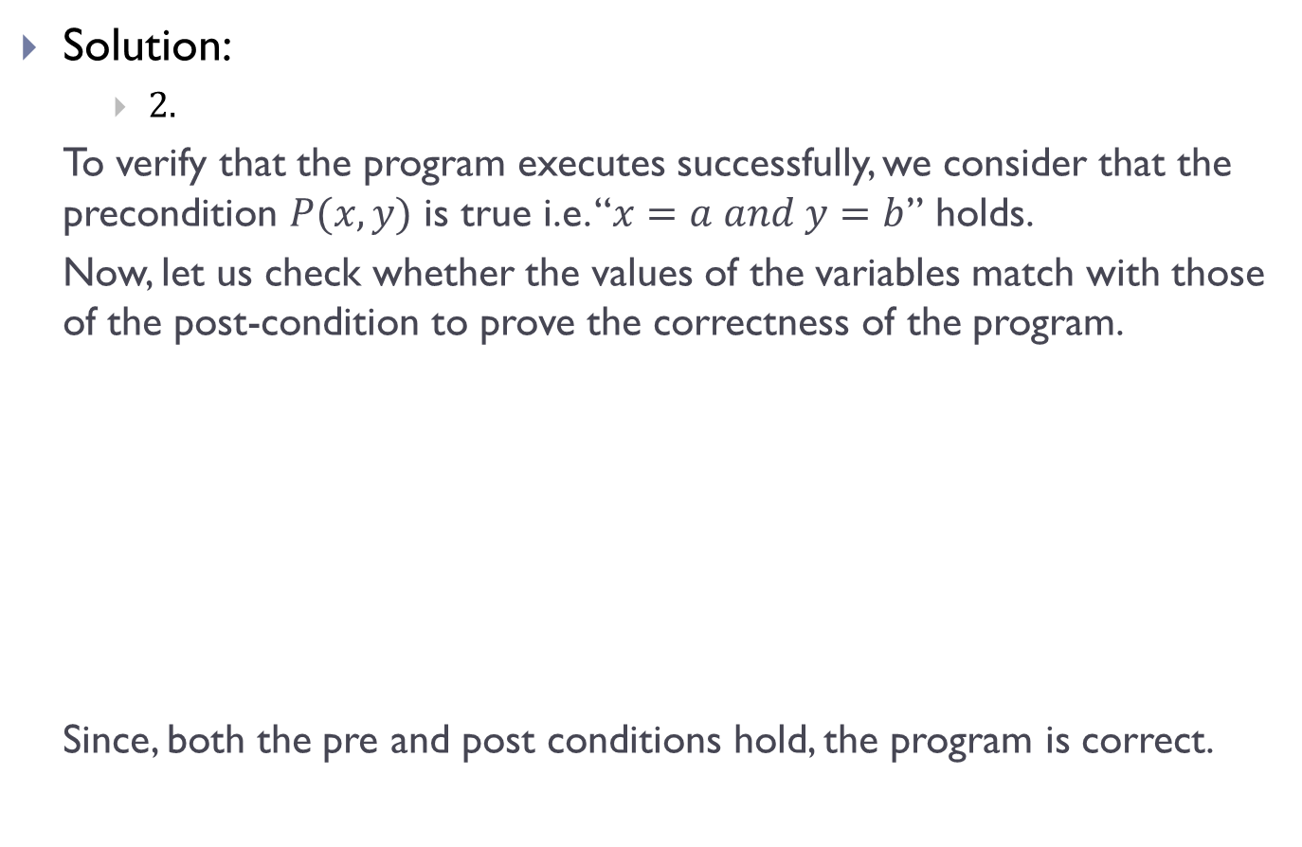
Predicates(Contd.)
Solution:
$2.$
To verify that the program executes successfully, we consider that the precondition $P(x,y)$ is true i.e. “$x=a and y=b$” holds.
Now, let us check whether the values of the variables match with those of the post-condition to prove the correctness of the program.
Since, both the pre and post conditions hold, the program is correct.
$$Steps$$ | $$Values$$ | $$Decision$$
$$temp := x$$ | $$x=a, temp=a, y=b$$ | $$Precondition holds$$
$$x:=y$$ | $$x=b,temp=a,y=b$$ | $$−$$
$$y := temp$$ | $$x=b, temp=a. y=a$$ | $$Postcondition holds$$

Slide 10
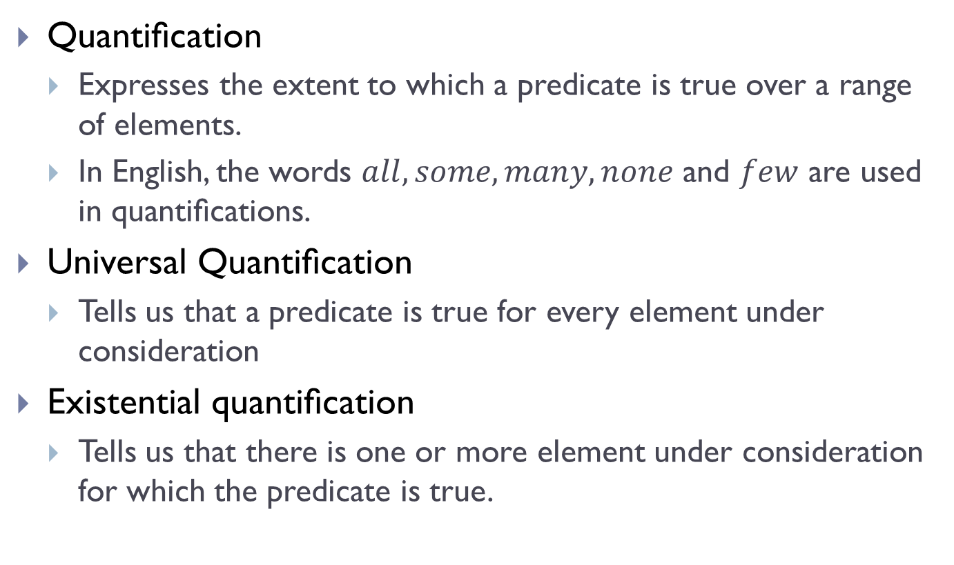
Quantifier and Classifications
Quantiﬁcation
Expresses the extent to which a predicate is true over a range of elements.
In English, the words $all, some, many, none$ and $few$ are used in quantiﬁcations.
Universal Quantiﬁcation
Tells us that a predicate is true for every element under consideration
Existential quantiﬁcation
Tells us that there is one or more element under consideration for which the predicate is true.

Slide 11

Predicate Calculus
The area of logic that deals with predicates and quantifiers is known as $predicate calculus$

Slide 12
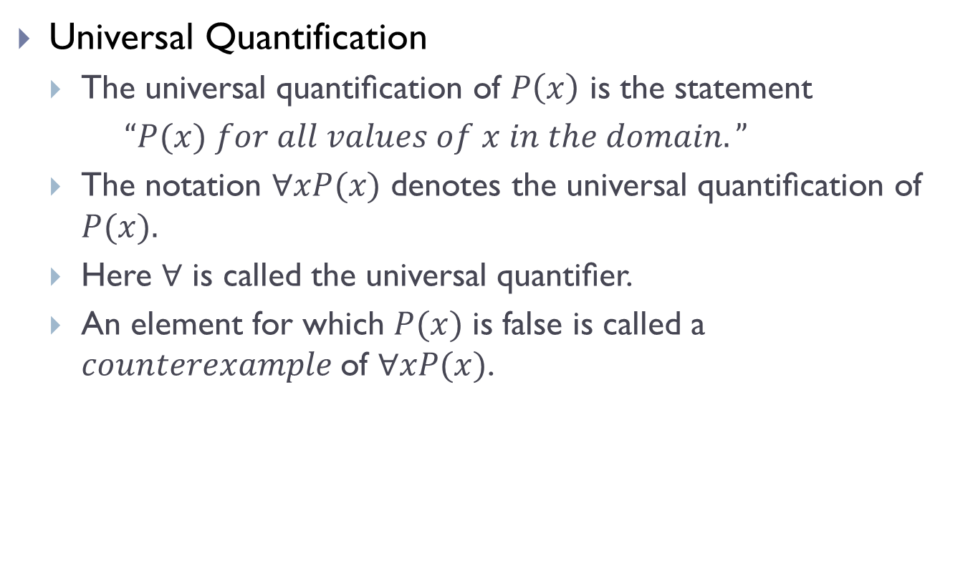
Universal Quantifiers
Universal Quantification
The universal quantiﬁcation of $P\left(x\right)$ is the statement
$“P(x) for all values of x in the domain.”$
The notation $∀xP(x)$ denotes the universal quantiﬁcation of $P(x).$
Here $∀$ is called the universal quantiﬁer.
An element for which $P(x)$ is false is called a $counterexample$of $∀xP(x)$.

Slide 13
Universal Quantifiers(Contd.)
Phrases used to express universal quantifiers
“for all”
“for every”
“all of”
“for each”
“given any”
“for arbitrary”
“for each”
“for any.”

Slide 14
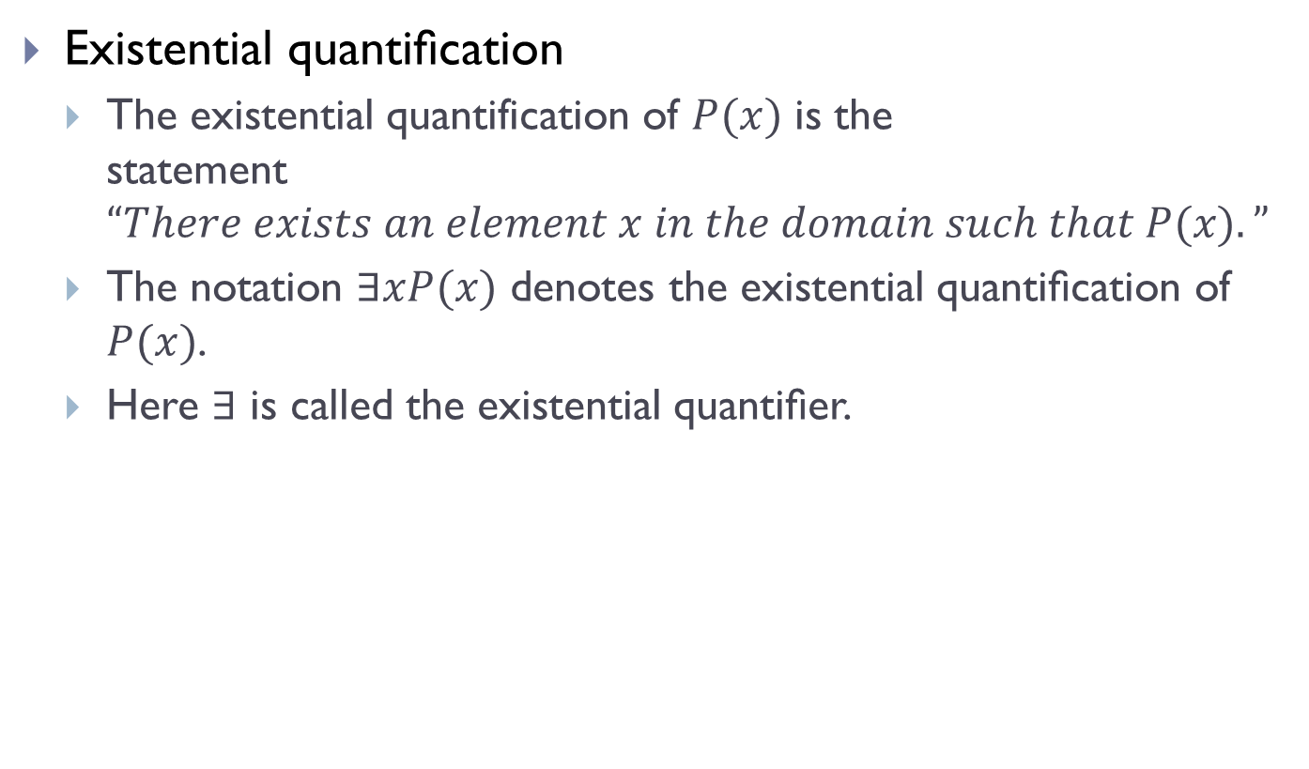
Existential Quantifiers
Existential quantiﬁcation
The existential quantification of $P(x)$ is the statement$“There exists an element x in the domain such that P(x).”$
The notation $∃xP(x)$ denotes the existential quantiﬁcation of $P(x)$.
Here ∃ is called the existential quantiﬁer.

Slide 15
Existential Quantifiers(Contd.)
Phrases used to express existential quantifiers
“there exists”
“for some”
“for at least one”
“there is.”

Slide 16
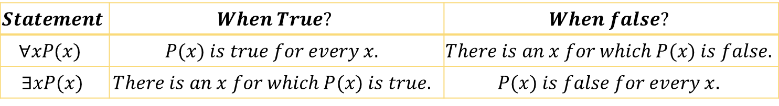
Truth Value of quantifiers
$$Statement$$ | $$When True?$$ | $$When false?$$
$$∀xP(x)$$ | $$P(x) is true for every x.$$ | $$There is an x for which P(x) is false.$$
$$∃xP(x)$$ | $$There is an x for which P(x) is true.$$ | $$P(x) is false for every x.$$

Slide 17
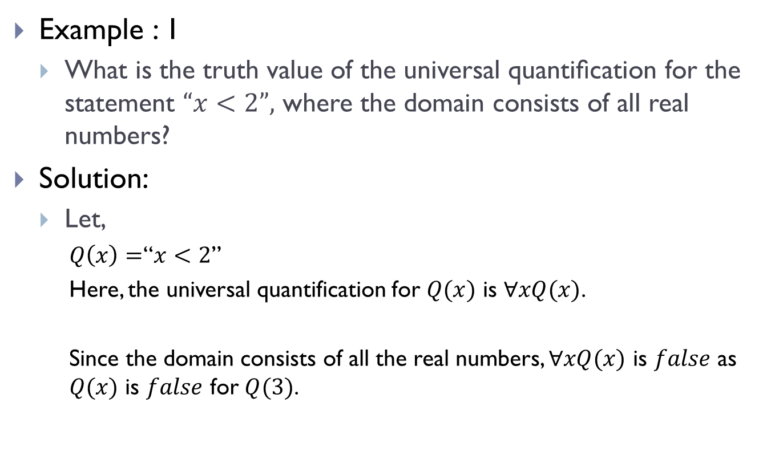
Examples of Quantifiers
Example : 1
What is the truth value of the universal quantiﬁcation for the statement $“x<2”,$ where the domain consists of all real numbers?
Solution:
Let,
$Q\left(x\right)=$“$x<2$”
Here, the universal quantification for $Q(x)$ is $∀xQ(x)$.
Since the domain consists of all the real numbers, $∀xQ(x)$ is $false$ as $Q(x)$ is $false$ for $Q(3)$.

Slide 18
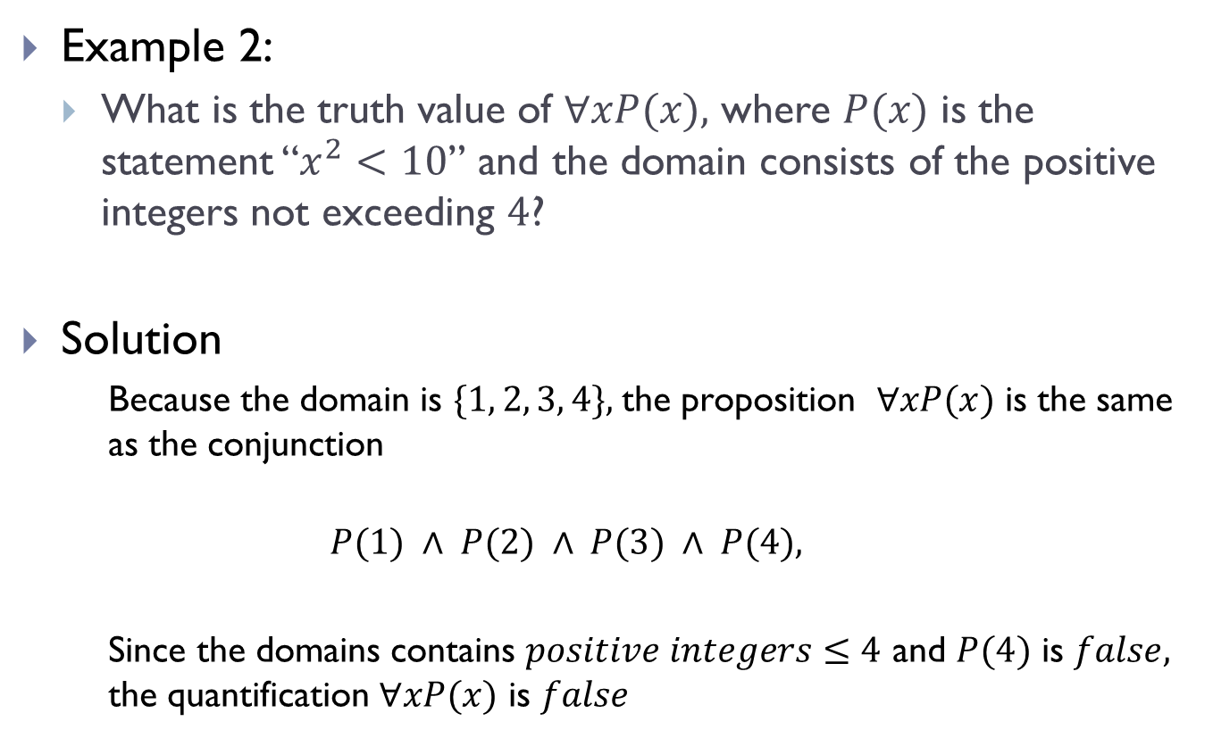
Examples of Quantifiers(Contd.)
Example 2:
What is the truth value of $∀xP(x),$ where $P(x)$ is the statement “$x^{2}<10$” and the domain consists of the positive integers not exceeding $4$?
Solution
Because the domain is $\{1, 2, 3, 4\},$the proposition $∀xP(x)$ is the same as the conjunction
$$P(1) ∧ P(2) ∧ P(3) ∧ P(4),$$
Since the domains contains $positive integers≤4$ and $P(4)$ is $false,$ the quantification $∀xP(x)$ is $false$

Slide 19
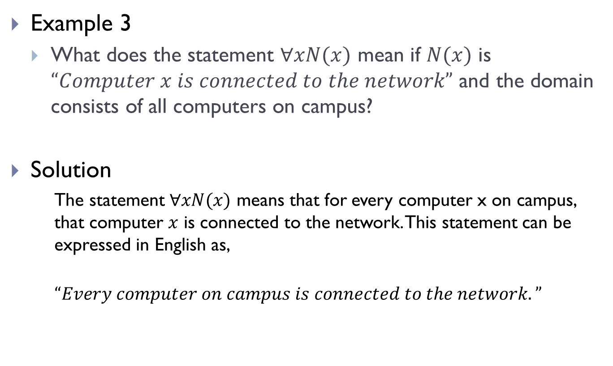
Examples of Quantifiers(Contd.)
Example 3
What does the statement $∀xN(x)$ mean if $N(x)$ is $“Computer x is connected to the network”$ and the domain consists of all computers on campus?
Solution
The statement $∀xN(x)$ means that for every computer x on campus, that computer $x$ is connected to the network. This statement can be expressed in English as,
$$“Every computer on campus is connected to the network.”$$

Slide 20
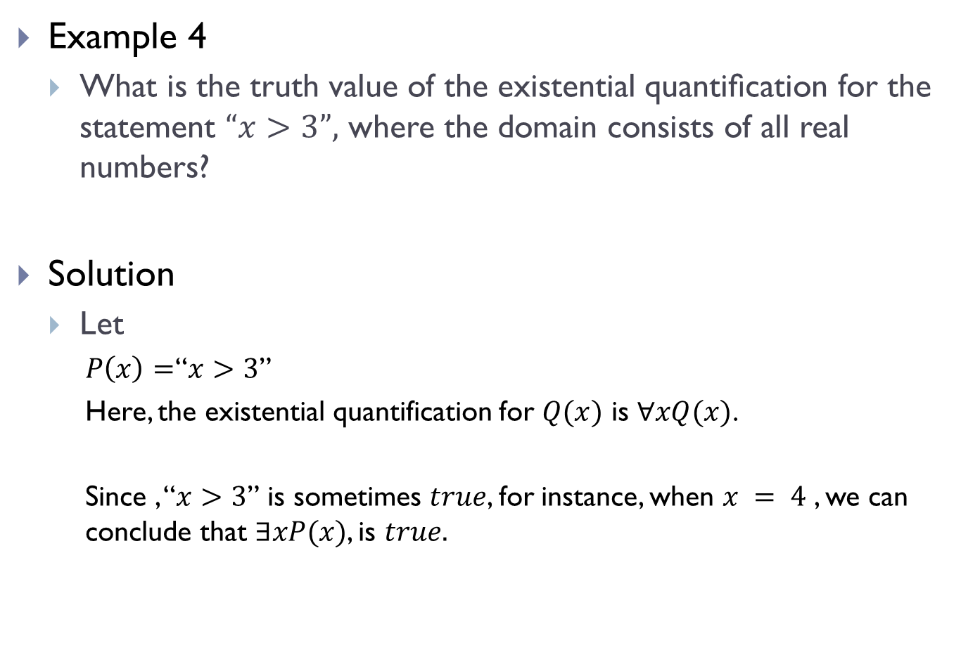
Examples of Quantifiers(Contd.)
Example 4
What is the truth value of the existential quantiﬁcation for the statement $“x>3”,$ where the domain consists of all real numbers?
Solution
Let
$P\left(x\right)=$“$x>3$”
Here, the existential quantification for $Q(x)$ is $∀xQ(x)$.
Since , “$x>3$” is sometimes $true$, for instance, when $x = 4$ , we can conclude that $∃xP(x)$, is $true.$

Slide 21
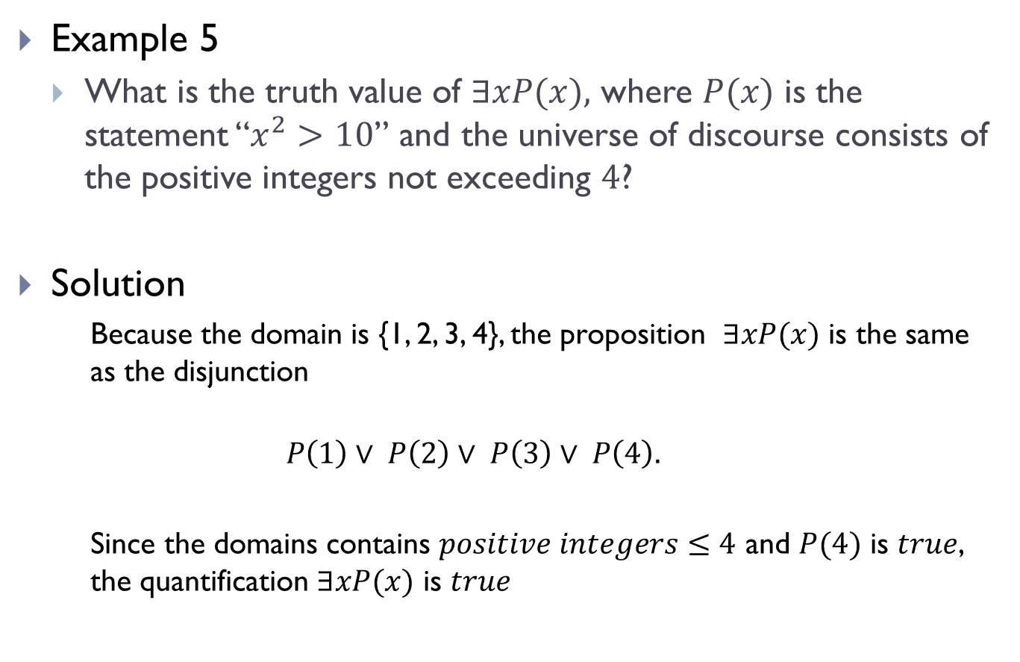
Examples of Quantifiers(Contd.)
Example 5
What is the truth value of $∃xP(x),$ where $P(x)$ is the statement “$x^{2}>10$” and the universe of discourse consists of the positive integers not exceeding $4$?
Solution
Because the domain is {1, 2, 3, 4}, the proposition $∃xP(x)$ is the same as the disjunction
$$P\left(1\right)∨ P\left(2\right)∨ P\left(3\right)∨ P\left(4\right).$$
Since the domains contains $positive integers≤4$ and $P(4)$ is $true$, the quantification $∃xP(x)$ is $true$

Slide 22
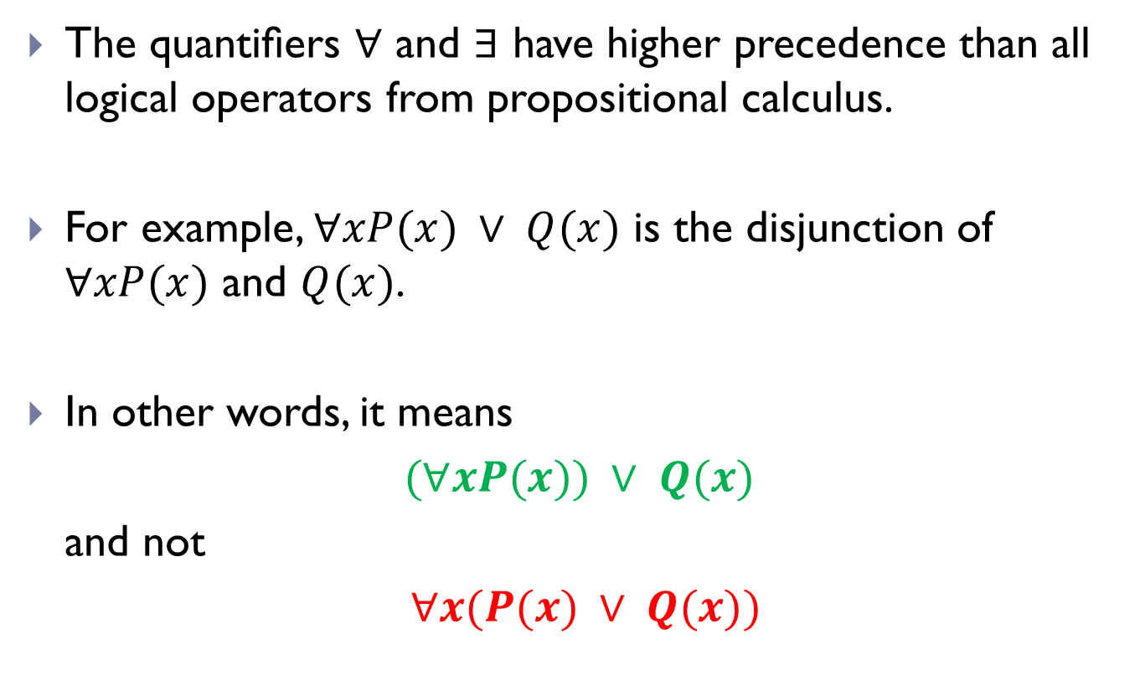
Precedence of quantifiers
The quantiﬁers $∀$ and $∃$ have higher precedence than all logical operators from propositional calculus.
For example, $∀xP(x) ∨ Q(x)$ is the disjunction of $∀xP(x)$ and $Q(x)$.
In other words, it means
$(∀xP(x)) ∨ Q(x)$
and not
$∀x(P(x) ∨ Q(x))$

Slide 23
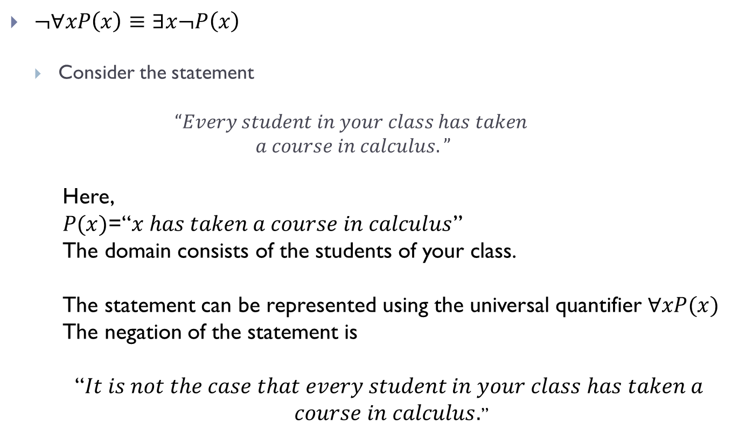
Logical Equivalence
$¬∀xP\left(x\right)≡∃x¬P\left(x\right)$
Consider the statement
$$“Every student in your class has taken$$
$$a course in calculus.”$$
Here,
$P(x)$=“$x has taken a course in calculus$”
The domain consists of the students of your class.
The statement can be represented using the universal quantifier $∀xP(x)$
The negation of the statement is
“$It is not the case that every student in your class has taken a$
$course in calculus.$”

Slide 24
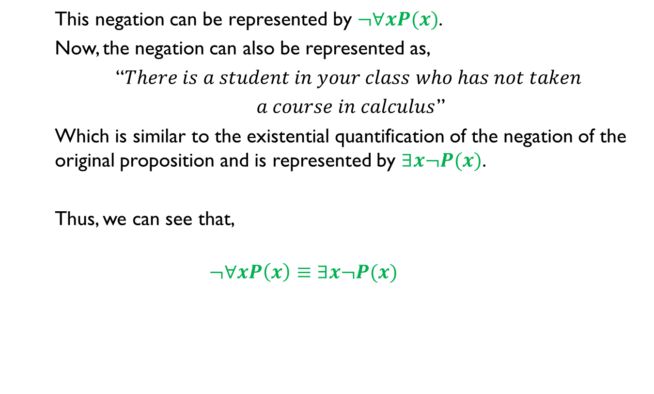
Logical Equivalence(Contd.)
This negation can be represented by $¬∀xP(x)$.
Now, the negation can also be represented as,
“$There is a student in your class who has not taken$
$a course in calculus$”
Which is similar to the existential quantification of the negation of the original proposition and is represented by $∃x¬P(x)$.
Thus, we can see that,
$$¬∀xP\left(x\right)≡∃x¬P(x)$$

Slide 25
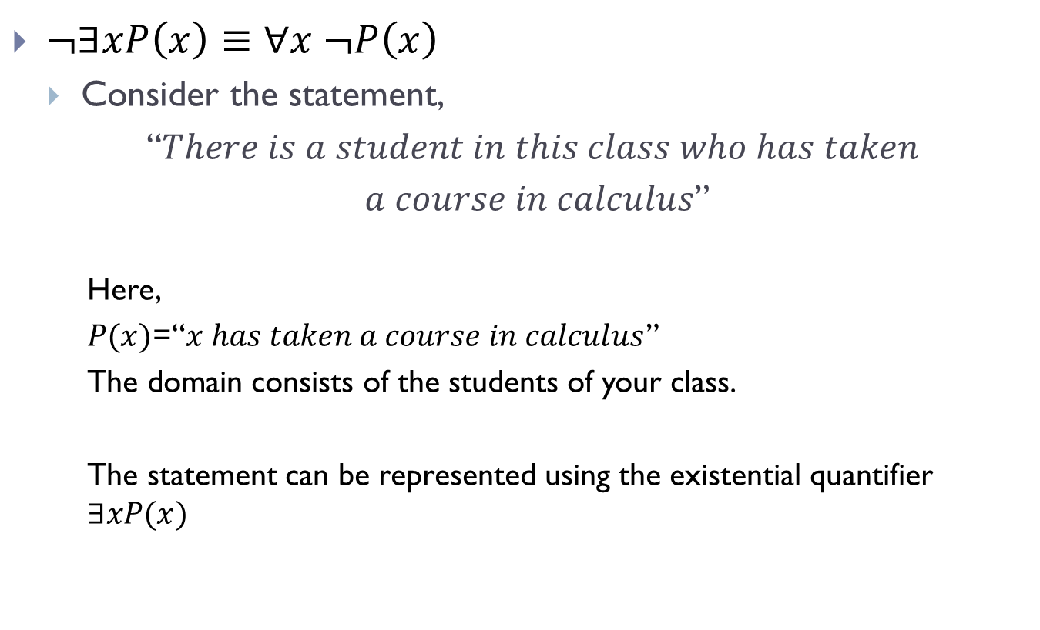
Logical Equivalences(Contd.)
$¬∃xP\left(x\right)≡∀x ¬P\left(x\right)$
Consider the statement,
“$There is a student in this class who has taken$
$a course in calculus$”
Here,
$P(x)$=“$x has taken a course in calculus$”
The domain consists of the students of your class.
The statement can be represented using the existential quantifier $∃xP(x)$

Slide 26
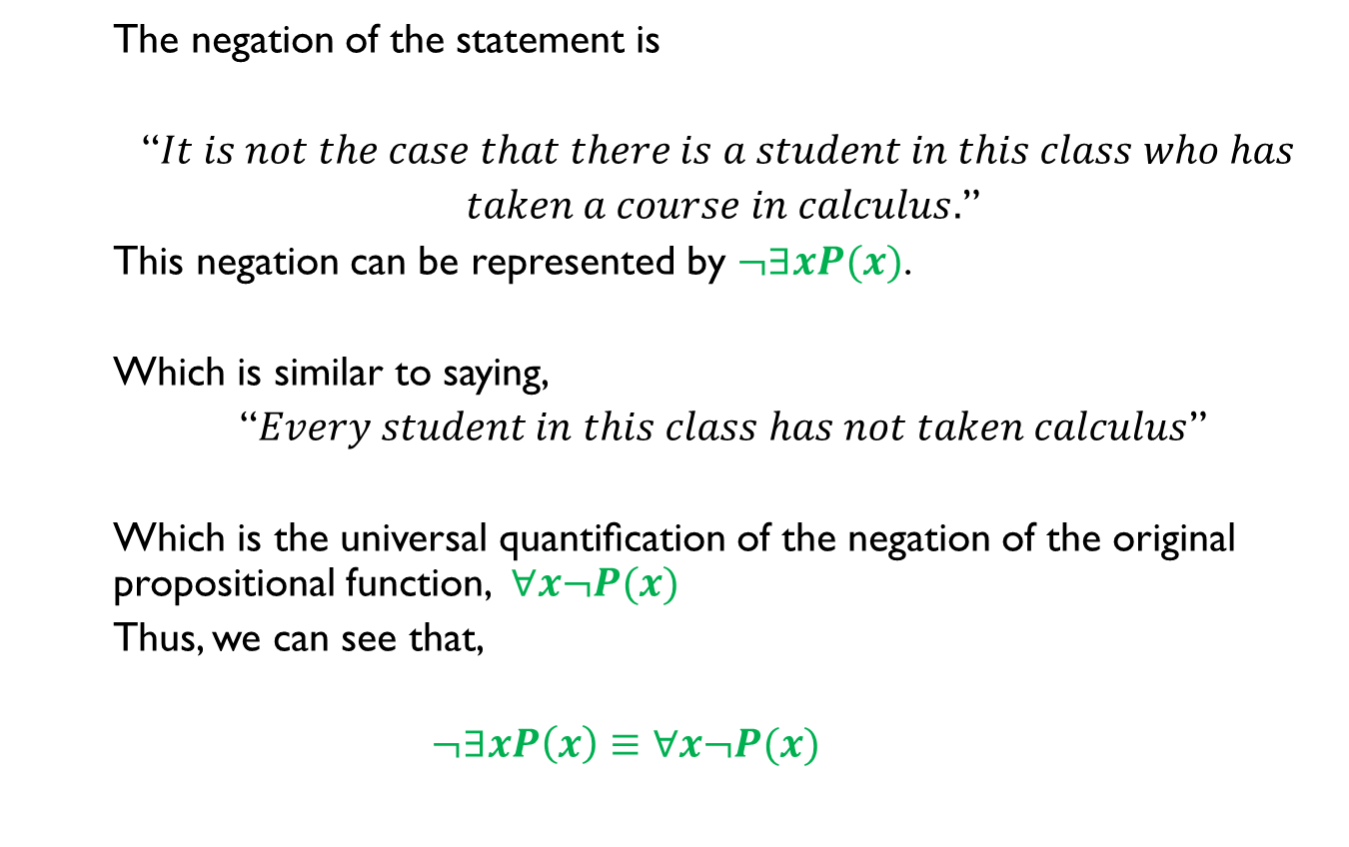
Logical Equivalences(Contd.)
The negation of the statement is
“$It is not the case that there is a student in this class who has$
$taken a course in calculus.$”
This negation can be represented by $¬∃xP(x)$.
Which is similar to saying,
“$Every student in this class has not taken calculus$”
Which is the universal quantiﬁcation of the negation of the original propositional function, $∀x¬P(x)$
Thus, we can see that,
$$¬∃xP\left(x\right)≡∀x¬P(x)$$

Slide 27
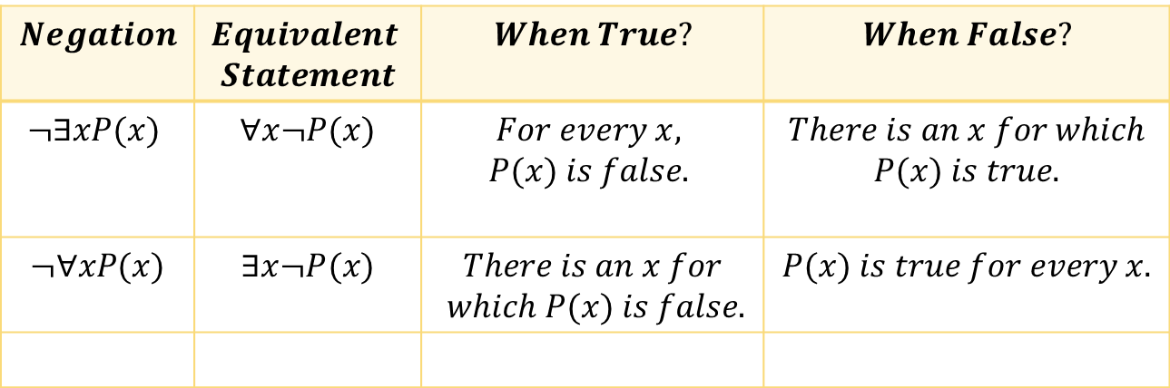

Logical equivalences(Contd.)
The rules for negations for quantiﬁers are called $De Morgan’s laws for quantiﬁers$
$$Negation$$ | $$Equivalent$$ $$Statement$$ | $$When True?$$ | $$When False?$$
$$¬∃xP(x)$$ | $$∀x¬P(x)$$ | $$For every x,$$ $$P(x) is false.$$ | $$There is an x for which$$ $$P(x) is true.$$
$$¬∀xP(x)$$ | $∃x¬P(x)$ | $$There is an x for$$ $$which P(x) is false.$$ | $$P(x) is true for every x.$$

Slide 28
Logical Equivalences(Contd.)
What are the negations of the statement? Express using Quantifiers.
“There is an honest politician”
“All Americans eat cheeseburgers”?

Slide 29
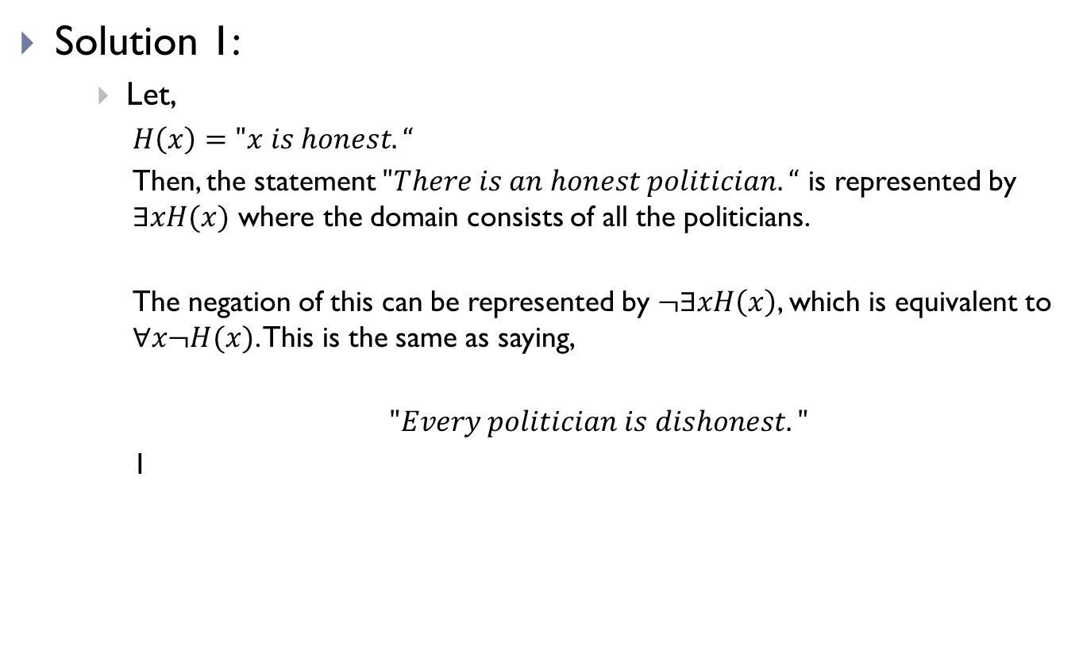
Logical Equivalences(Contd.)
Solution 1:
Let,
$H\left(x\right)=$ $"x is honest.“$
Then, the statement $"There is an honest politician.“$ is represented by $∃xH(x)$ where the domain consists of all the politicians.
The negation of this can be represented by $¬∃xH\left(x\right)$, which is equivalent to $∀x¬H(x)$. This is the same as saying,
$"Every politician is dishonest. "$
1

Slide 30

Logical Equivalences(Contd.)
Solution 2:
Let,
$C\left(x\right)=$ $"x eats cheeseburgers.“$
Then, the statement $"All Americans eat cheeseburgers.“$ is represented by$∀xC(x)$, where the domain consists of all Americans.
The negation of this can be represented by $¬∀xC(x)$, which is equivalent to $∃x¬C(x)$. This is the same as saying,
$$"There is an American who does not eat cheeseburgers."$$

Slide 31
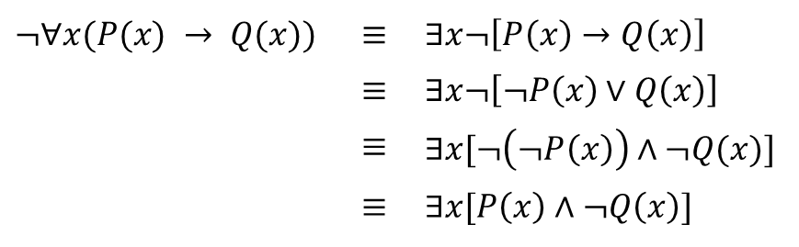

Logical Equivalences(Contd.)
Show that $¬∀x(P(x)→Q(x))$and $∃x[P\left(x\right)∧¬Q\left(x\right)]$are logically equivalent.
Solution:
$$¬∀x(P(x) → Q(x))$$ | $$≡$$ | $∃x¬\left[P\left(x\right)→Q\left(x\right)\right]$
 | $$≡$$ | $∃x¬\left[¬P\left(x\right)∨Q\left(x\right)\right]$
 | $$≡$$ | $∃x[¬\left(¬P\left(x\right)\right)∧¬Q(x)]$
 | $$≡$$ | $∃x[P\left(x\right)∧¬Q\left(x\right)]$

Slide 32
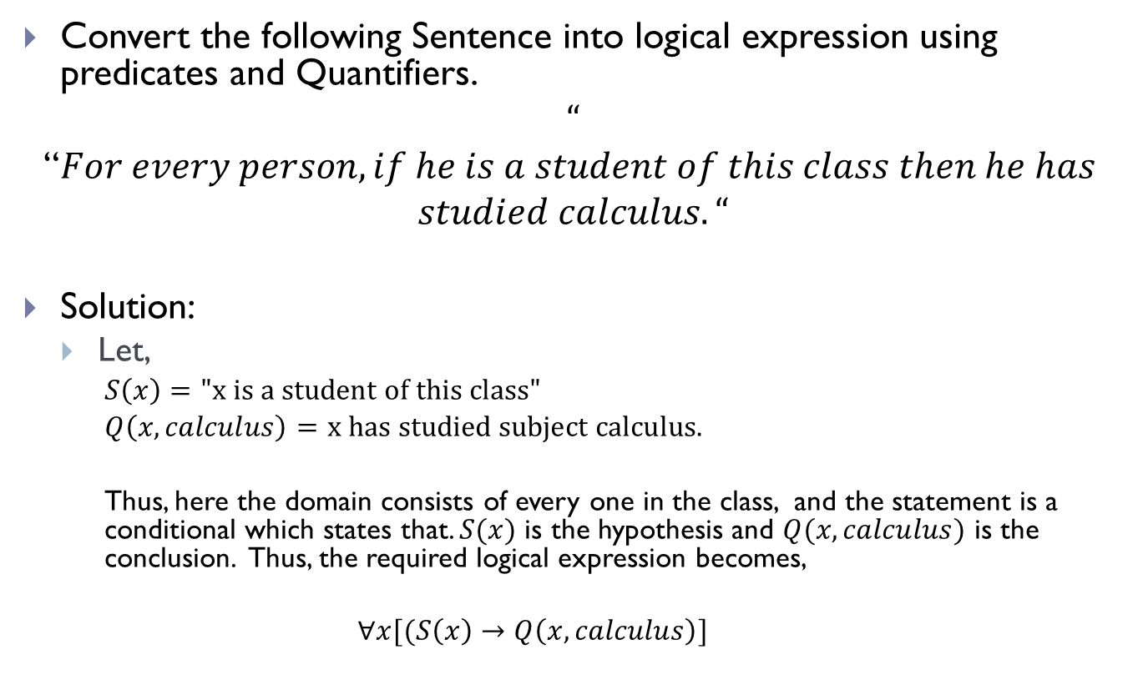
Logical Expression using Quantifiers
Convert the following Sentence into logical expression using predicates and Quantifiers.
$$“$$
“$For every person, if he is a student of this class then he has$
$$studied calculus.“$$
Solution:
Let,
$S\left(x\right)=$ $"\text{x} \text{is} \text{a} \text{student} \text{of} \text{this} \text{class}\text{"}$
$Q\left(x,calculus\right)=$ $\text{x} \text{has} \text{studied} \text{subject} \text{calculus}\text{.}$
Thus, here the domain consists of every one in the class, and the statement is a conditional which states that. $S(x)$ is the hypothesis and $Q(x, calculus)$ is the conclusion. Thus, the required logical expression becomes,
$$∀x[(S\left(x\right)→Q\left(x,calculus\right)]$$

Slide 33
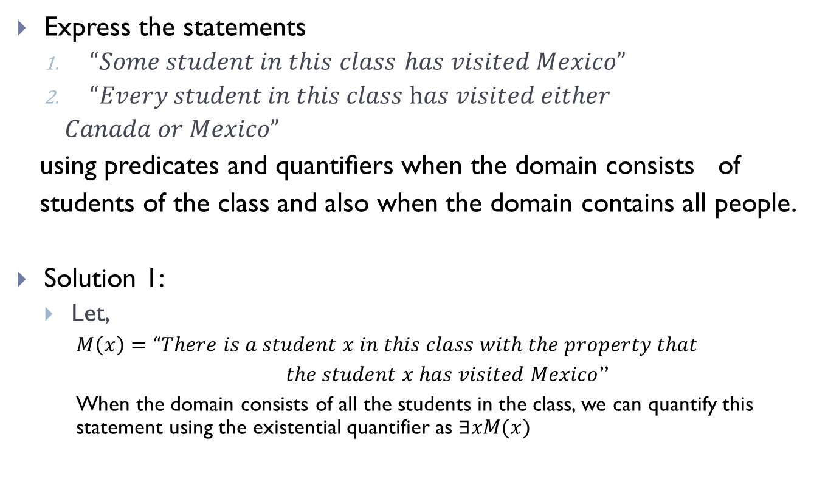
Logical Expression using Quantifiers(Contd.)
Express the statements
$“Some student in this$ $class$ $has visited Mexico”$
$“Every student in this class has visited either$
$Canada or Mexico”$
using predicates and quantiﬁers when the domain consists of
students of the class and also when the domain contains all people.
Solution 1:
Let,
$M\left(x\right)=$ $“There is a student x in this class with the property that$
$the student x has visited Mexico$”
When the domain consists of all the students in the class, we can quantify this statement using the existential quantifier as $∃xM(x)$

Slide 34
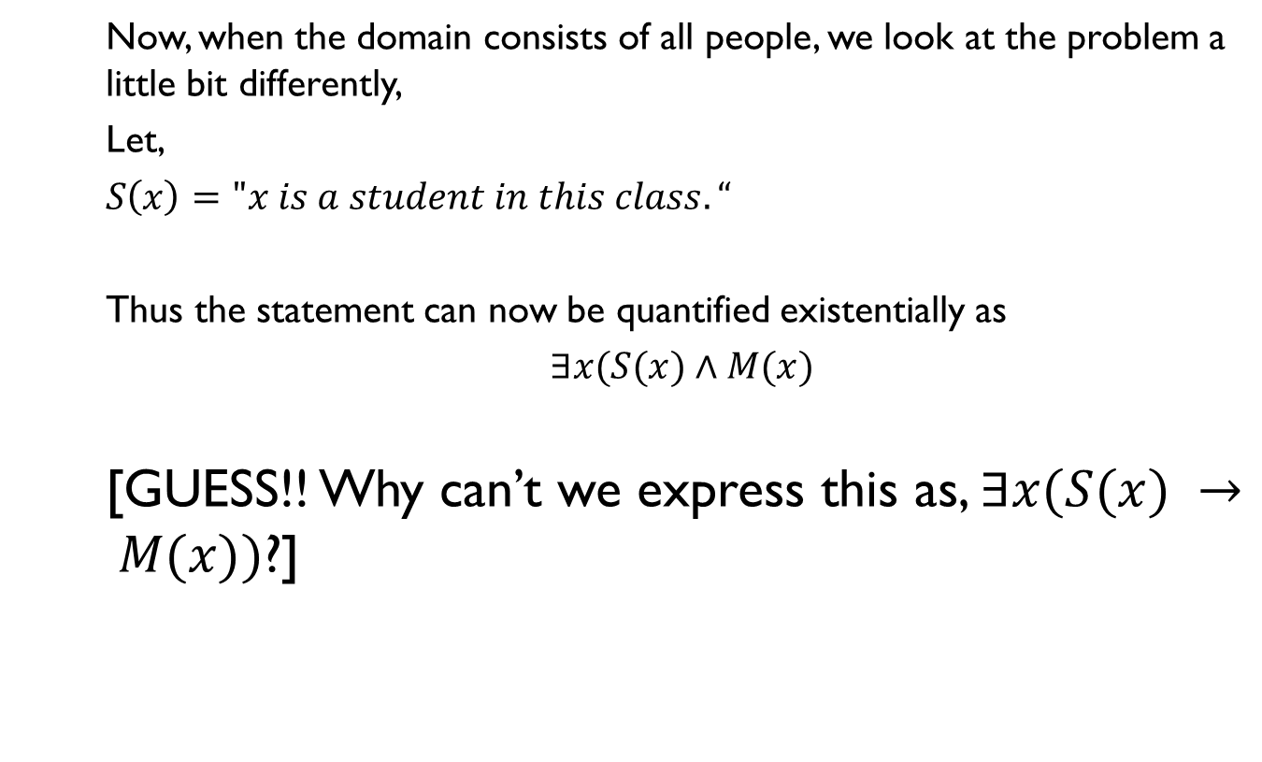
Logical Expression using Quantifiers(Contd.)
Now, when the domain consists of all people, we look at the problem a little bit differently,
Let,
$S\left(x\right)="x is a student in this class.“$
Thus the statement can now be quantified existentially as
$∃x(S(x)∧M(x)$
[GUESS!! Why can’t we express this as, $∃x(S(x) → M(x))$?]

Slide 35

Logical Expression using Quantifiers(Contd.)
The reason is that, the statement is existentially quantified, that means, not all the students have visited Mexico and therefore when we look at the domain containing all the people, the statement cannot be expressed as $∃x\left(S\left(x\right)→ M\left(x\right)\right),$ which is true when there is someone not in the class because, in that case, for such a person $x, S(x) → M(x)$ becomes either $F →T$ or $F →F$, both of which are true.

Slide 36
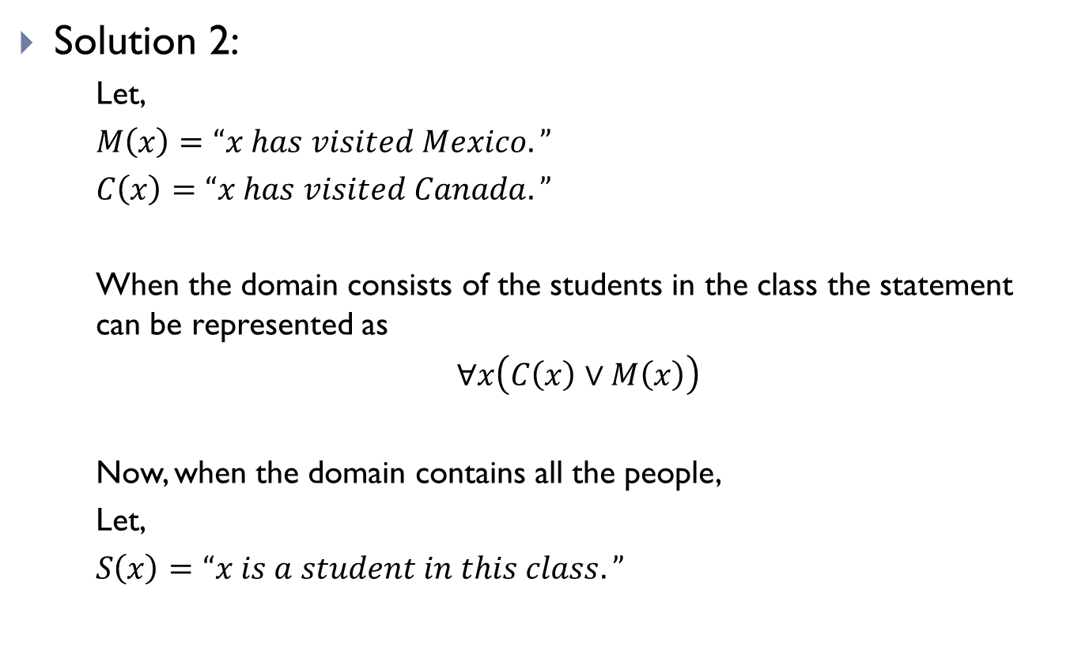
Logical Expression using Quantifiers(Contd.)
Solution 2:
Let,
$M\left(x\right)=“x has visited Mexico.”$
$C\left(x\right)=$ $“x has visited Canada.”$
When the domain consists of the students in the class the statement can be represented as
$∀x\left(C\left(x\right)∨M\left(x\right)\right)$
Now, when the domain contains all the people,
Let,
$S\left(x\right)=$ $“x is a student in this class.”$

Slide 37
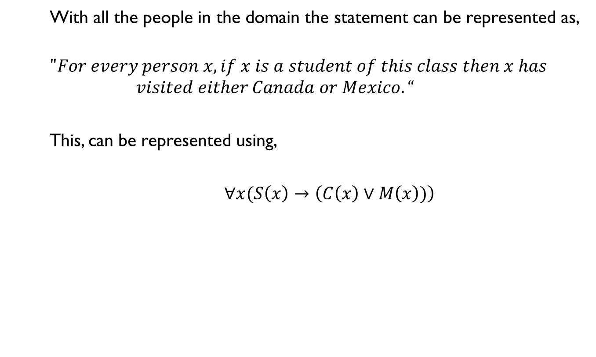
Logical Expression using Quantifiers(Contd.)
With all the people in the domain the statement can be represented as,
$$"For every person x, if x is a student of this class then x has$$
$$visited either Canada or Mexico.“$$
This, can be represented using,
$∀x(S\left(x\right)→\left(C\left(x\right)∨M\left(x\right))\right)$

Slide 38
THE END

